Slide 1




Results for the City of Anna
January 10th, 2023

Slide 2




Civic Communication & Analytics Platform
Smarter, better connected communities. A civic surveying, policy polling, and constituent communication tech platform.
Advanced Survey Science & Performance Analytics
Data insights to help communities move forward.
The premiere provider of professional civic surveys
and performance benchmarking analyses.
Exclusive partners of:
Questions about our product?
Visit www.polco.us to learn more
Notes:
I am happy to be here to present a summary of the findings from the Anna resident survey.
Before I begin, on behalf of myself and my Polco/NRC coworkers, I’d like to thank Kimberly Winarski, the primary contact for us during the survey development and implementation process. She was a pleasure to work with, and provided thoughtful feedback throughout the project.
I would also like to acknowledge my colleague, Alissa Punwar, who was the project manager for the survey, and who actually did the work for your survey project!
NRC
National Research Center (NRC) at Polco gives local governments, and other public sector organizations, the data they need to make more informed decisions. For over 25 years, we've worked with hundreds of jurisdictions nationwide.
NRC is best known for our national benchmarking surveys, such as The National Community Survey (The NCS), and custom survey research. This benchmark database holds hundreds of thousands of resident opinions – making it the largest of its kind in the United States.
Our research reveals community perspectives that are representative, reliable, and ready to enact.
POLCO
Polco’s online community engagement polling platform provides the information tools local governments and other public sector leaders need
Now, hundreds of organizations nationwide use Polco for strategic planning, budgeting, and empowering resident voices. We make civil, verified community engagement online not only possible, but accessible
NRC and Polco merged in 2019 to effectively serve local government and project resident voices
ALSO
Partners with
International City/County Managers Association (ICMA)
The National League of Cities (NLS)
Engaged Local Government Leaders (ELGL)
Alliance for Innovation (AFI)
Work closely with American Association for Public Opinion Research

Slide 3



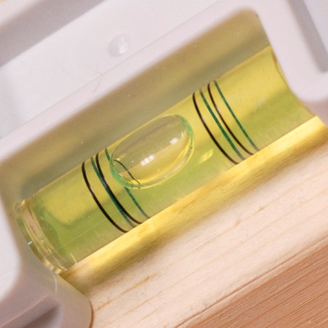
Role of Resident Surveys in Local Governance
Monitor trends in resident opinion
Measure government performance
Inform budget, land use, strategic planning decisions
Benchmark service ratings
Notes:
I want to emphasize that there are a variety of ways these results can be used. Most commonly, the jurisdictions we work with use this data to monitor trends in resident opinion over time, measure government performance, and to inform budgeting processes and strategic plans. Our results also allow you to benchmark your community’s specific services against those same services within other communities that have conducted the NCS with us. I hope that as these findings are presented, it will spur ideas for you in what could be done with these results, or where you might want to dig deeper.

Slide 4
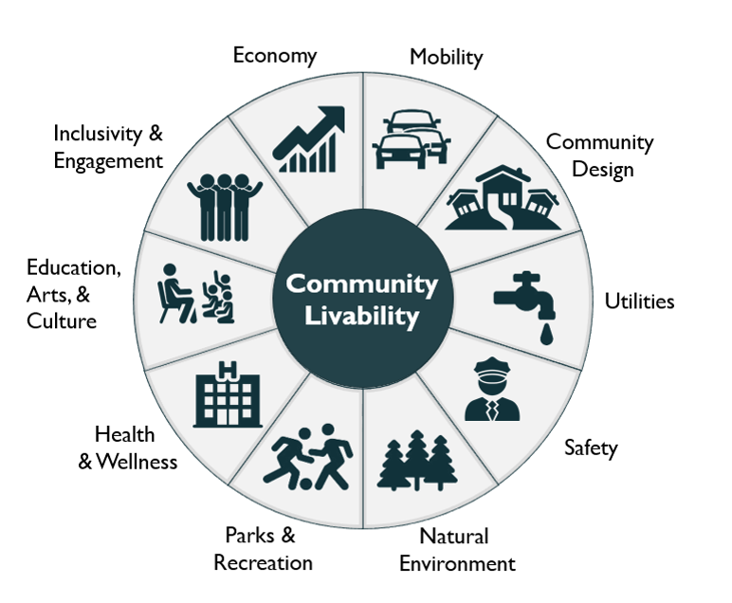
Facets of Community Livability
4
Notes:
The National Community Survey, or The NCS, is a standardized 5-page comprehensive survey that allows municipalities and counties to assess resident opinion about their community and local government. The NCS focuses on the “livability” of Anna by focusing on 10 main facets of community livability. These facets have been identified by survey researchers as most vital to creating a high-quality community that people want to live in. The NCS survey includes items within each of these facets, to provide a picture of how residents feel about their community.

Slide 5

The National Community Survey™ in Anna
The NCS™ for Anna, TX
First time conducting The NCS
Survey conducted from September 21st, 2022 to November 9th, 2022
Mailing approach employed:
  Probability-based sample of 3,200 households
  375 total responses received
  12% overall response rate
  Non-probability, open-participation sample: 213 responses
Results statistically weighted to reflect Anna overall
95% confidence interval with a +/- 5% margin of error
Notes:
All households within the City of Anna were eligible to participate in the survey. A list of all households within the zip codes serving Anna was purchased based on updated listings from the United States Postal Service. Since some of the zip codes that serve the City households may also serve addresses that lie outside of the community, the exact geographic location of each housing unit was compared to community boundaries using the most current municipal boundary file. Addresses located outside of the City of Anna boundaries were removed from the list of potential households to survey. From that list, addresses were randomly selected as survey recipients.
The xx3,000 randomly selected households received mailings beginning on September 21st, 2022, and the survey remained open for 7 weeks. The first mailing was a postcard inviting the household to participate in the survey. The next mailing contained a cover letter with instructions, the survey questionnaire, and a postage-paid return envelope.
The survey was available in English.
A total of 375 completed surveys were received from these efforts, providing a response rate of 12% and a margin of error of plus or minus 5 percentage points. We then compared the demographic profile of survey respondents to that of adults in Anna. We then “weighted” the survey results, a survey research best practice.
In addition to the randomly selected “probability sample” of households, a link to an online open participation survey was publicized by the City of Anna. The open participation survey was open to all City residents and became available on October 26th, 2022. The survey remained open for two weeks and 213 responses were received.
This presentation and the report are based on the xx405 responses from the probability sample survey.

Slide 6
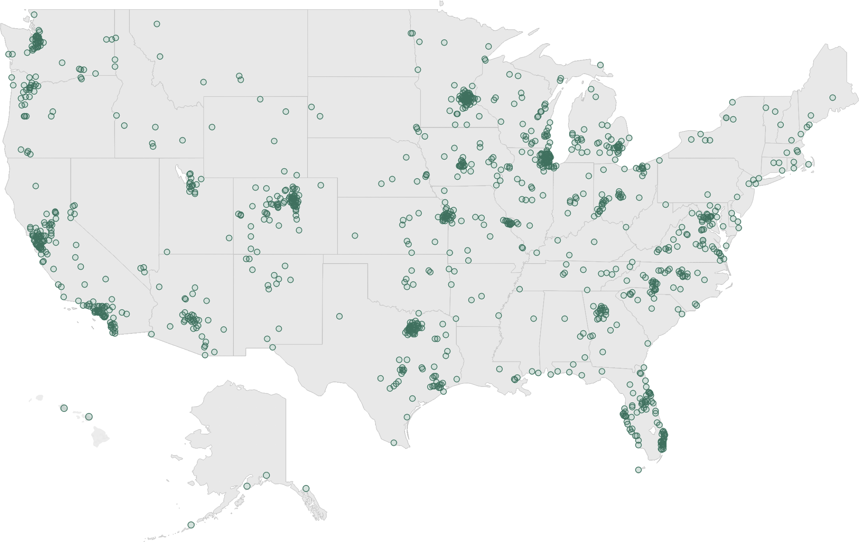
National Benchmark Comparison Database
More than 500 comparison communities across the nation.
Representing the opinions of more than 50 million residents.
Notes:
One of the advantages to a local government of participating in the NCS is the opportunity to compare ratings given by your residents to those from communities across the nation. National Research Center was the first organization to conceive of the idea to create benchmarks of public opinion. This allows jurisdictions to compare ratings of services to ratings of similar services from other communities. We find that services like library and fire tend to get higher ratings, while street repair tends to get lower ratings in every community. It makes more sense to compare street repair ratings in your community to ratings for street repair in other communities rather than pitting the ratings of street repair against fire service ratings.
There have been over 400 local governments who have conducted the NCS, but we cast the net even wider. Not only does our database include results from surveys we conducted that are not the NCS, but from surveys conducted by other jurisdictions. Any credible survey results we can find that have been made public are included. There are about 600 surveys in the database, and over 400 of them are ones that we have conducted.

Slide 7
Overview of Survey Results

Slide 8
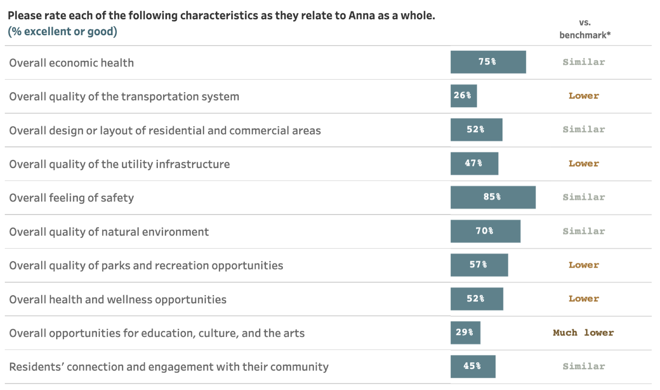
Facets of Community Livability:
Quality
Notes:
In the survey, we have two questions that ask directly about those 10 facets of community livability. This first asks residents to rate the quality of each, and you can see the resulting comparison to the national benchmark on the right-hand side.

Slide 9
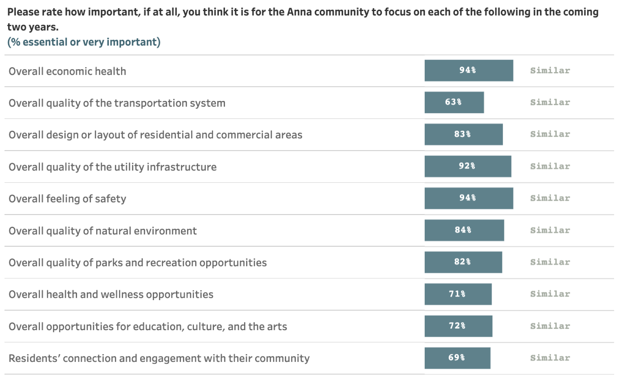
Facets of Community Livability:
Importance
Notes:
The second asks about the same facets of livability, but is centered on how important residents think it is for the community to focus on each facet in the coming two years. So we ask about both the quality and importance of each of these facets, and we use those answers to create the quality/importance matrix, which we’ll see on the next slide.

Slide 10
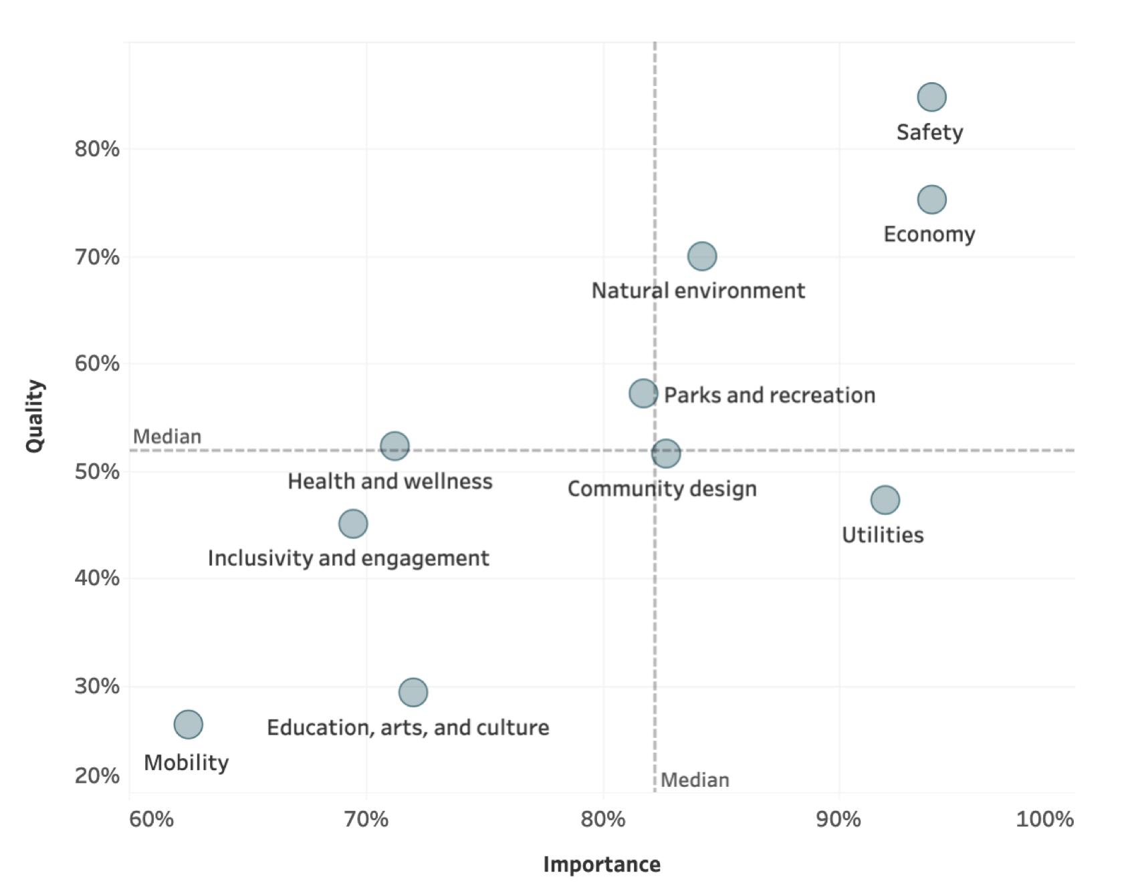
Balancing Quality and Importance
10
Notes:
We use this chart, which is also included in the report, to help determine which areas are of relatively higher importance and lower quality to residents—those are located in the lower-right quadrant as pictured. This chart can be used to influence key findings and help a community determine which areas may need additional focus in the coming years, and which others are performing well in comparison (and thus could potentially stand a slight decrease in funding or focus, if other priorities require it.

Slide 11
Comparisons to National Benchmarks
1
received
more positive
ratings
86
received similar
ratings
34
received more negative ratings
Notes:
Of the 129 survey items for which residents provided evaluative ratings, 1 received ratings higher than the national benchmark, 86 received similar ratings, and 36 received lower ratings (16 being much lower).
Higher
Treating all residents fairly
Lower
Overall quality of the transportation system
Overall quality of the utility infrastructure
Overall quality of parks and recreation opportunities
Overall health and wellness opportunities
Variety of business and service establishments
Employment opportunities
Ease of walking
Availability of paths and walking trails
Fitness opportunities
Availability of affordable quality food
Availability of affordable quality health care
Availability of preventive health services
Availability of affordable quality mental health care
Opportunities to attend cultural/arts/music activities
K-12 education
Snow removal
Recreation programs or classes
Health services
Anna as a place to work
Anna as a place to visit
Overall opportunities for education, culture, and the arts
Vibrancy of downtown/commercial area
Shopping opportunities
Ease of travel by public transportation
Ease of travel by bicycle
Public places where people want to spend time
Water resources
Recreational opportunities
Community support for the arts
Adult educational opportunities
Bus or transit services
Drinking water
Recreation centers or facilities
Public library services

Slide 12
Survey Highlights
Notes:
Moving now into the highlights of our findings, I do want to point a few items that stood out to us as survey researchers. There is a lot of additional data in the full report that we won’t cover tonight, but tonight’s presentation will focus on a few areas that we found to be most noteworthy within Anna’s survey results.

Slide 13


Most residents feel a strong sense of safety in Anna
Key Finding #1:

Slide 14
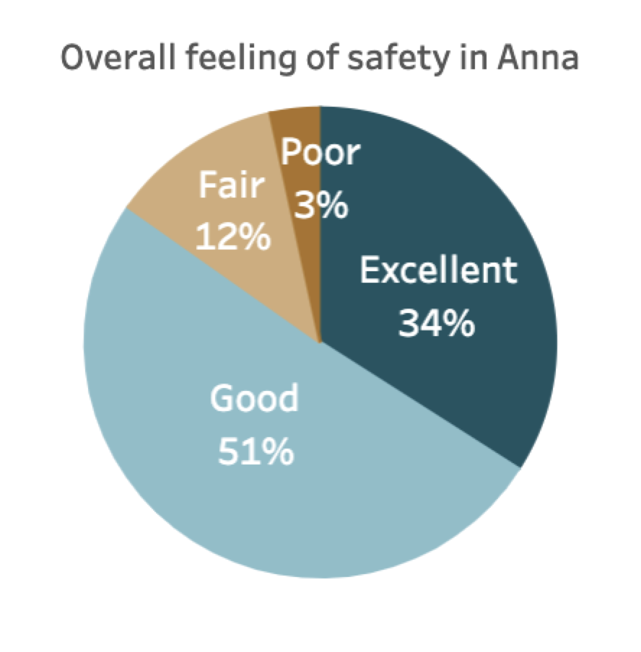
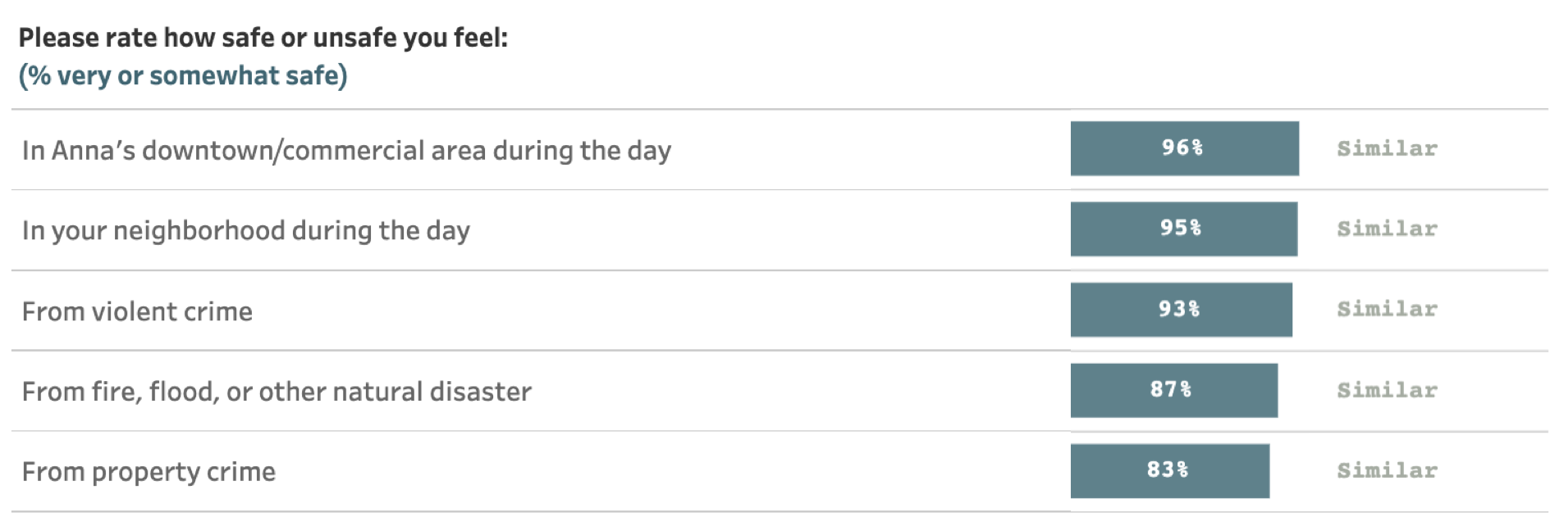
Safety in Anna
Notes:
Residents offered high ratings of importance (94% essential or very important) and quality (85% excellent or good) to the overall feeling of safety in Anna, suggesting that safety is a priority and a strength for the community. About 9 in 10 residents said they felt very or somewhat safe in the City’s downtown/commercial area, in their neighborhoods during the day, from violent crime, and from fire, flood or other natural disaster. Similarly, about 8 in 10 reported feeling safe from property crime.

Slide 15






Safety Services in Anna
93%
91%
89%
87%
84%
70%
Fire
services
Ambulance/Emergency medical services
Police services
Crime prevention
Fire prevention/ education
Animal control
Percent excellent or good
Notes:
The City’s safety services also received high marks from respondents. About 9 in 10 gave positive reviews to fire services, ambulance or emergency medical services, police/sheriff services, and crime prevention. All safety-related items on the survey were on par with national benchmark comparisons.

Slide 16

Anna’s economic health is important to residents
Key Finding #2:
Notes:
We have organized this presentation around what we found to be interesting or important findings.

Slide 17
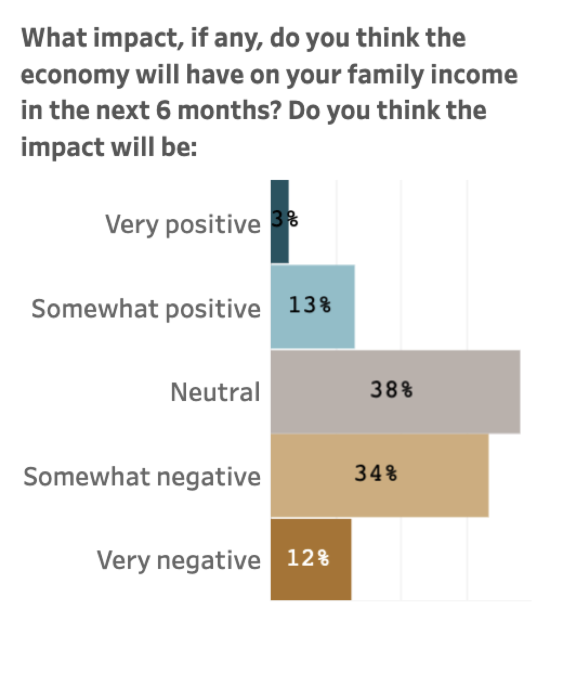
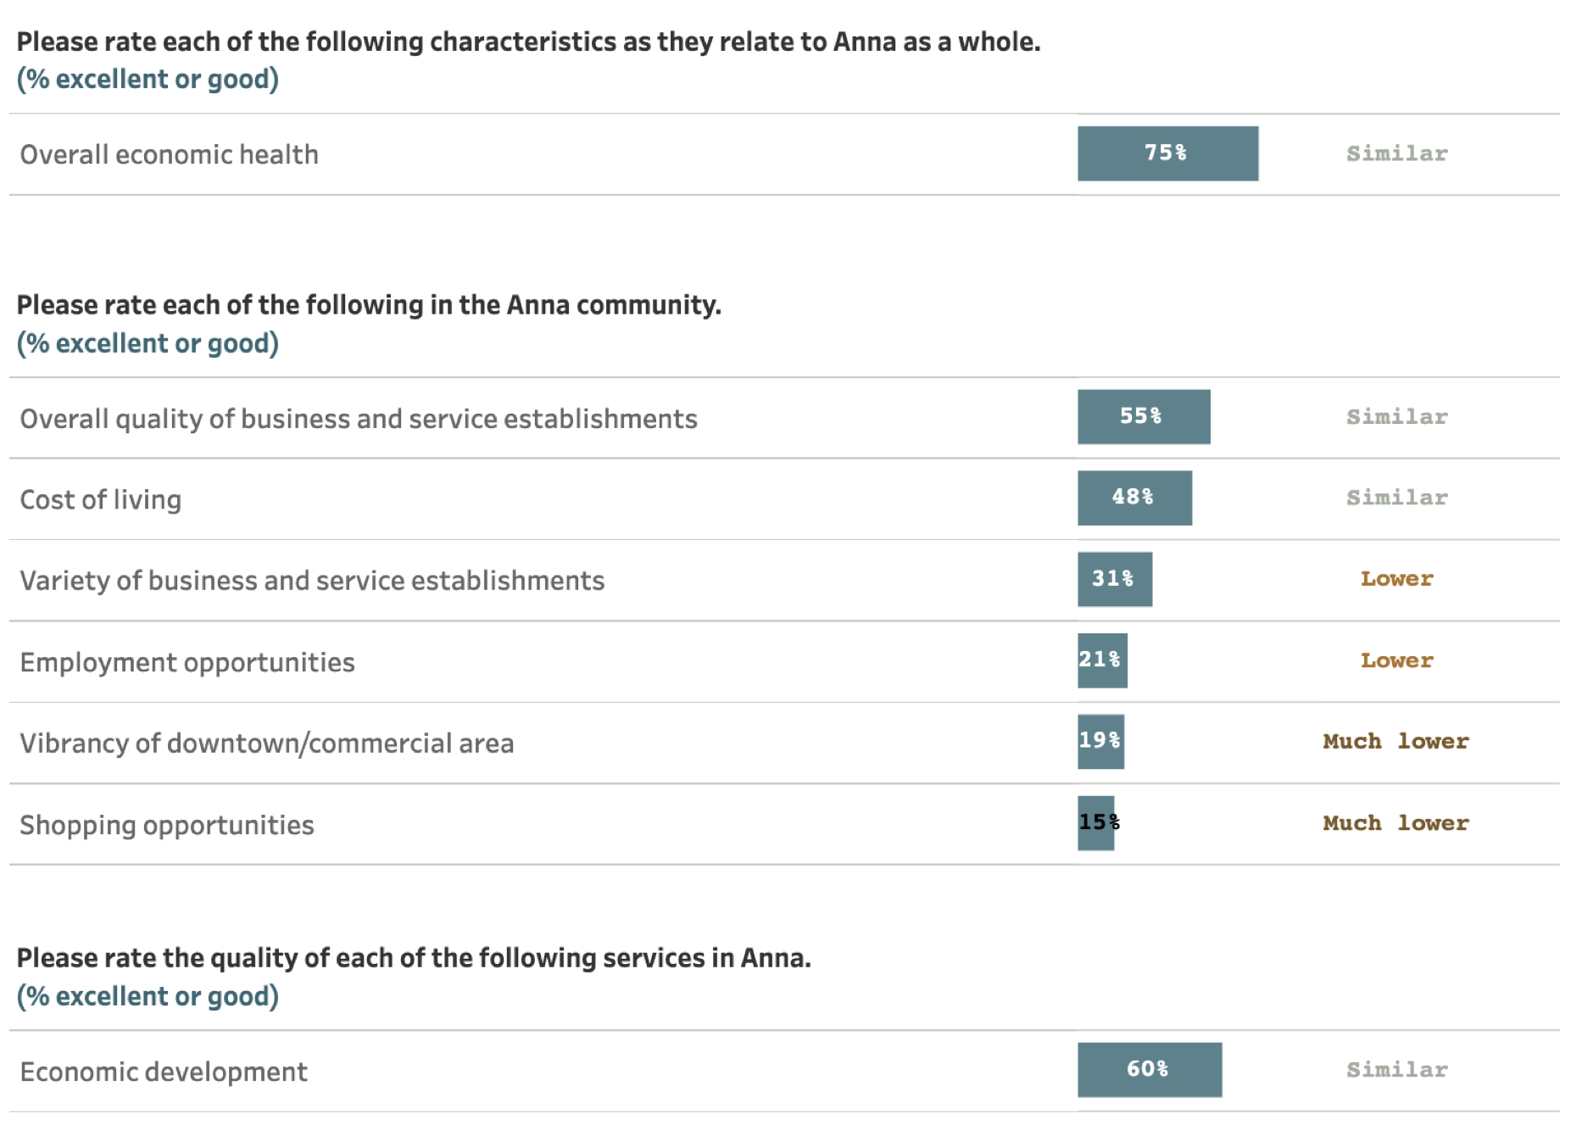
Public Trust
The Economy in Anna
Notes:
About 94% of residents indicated that economic health should be an area of focus for the City of Anna in the next two years. Three-quarters of residents rated the overall economic health of the City as excellent or good, scoring similar to the national average. The overall quality of business and service establishments and overall economic development were favorably evaluated by roughly 6 in 10 participants, while cost of living was rated positively by just under half (48%) of residents, all rating similar to benchmark comparisons. Like many other cities of comparable size and proximity to larger metropolitan areas, Anna received lower marks for the variety of business and service establishments, employment opportunities, vibrancy of downtown/commercial areas, and shopping opportunities, all of which fell below benchmark comparisons. When asked what impact, if any, the economy would likely have on their family income in the next six months, only 16% of residents expected the impact to be somewhat or very positive, scoring lower than the national benchmark.

Slide 18

Residents feel Anna’s natural environment and recreational opportunities are important and have room for growth
Key Finding #3:

Slide 19
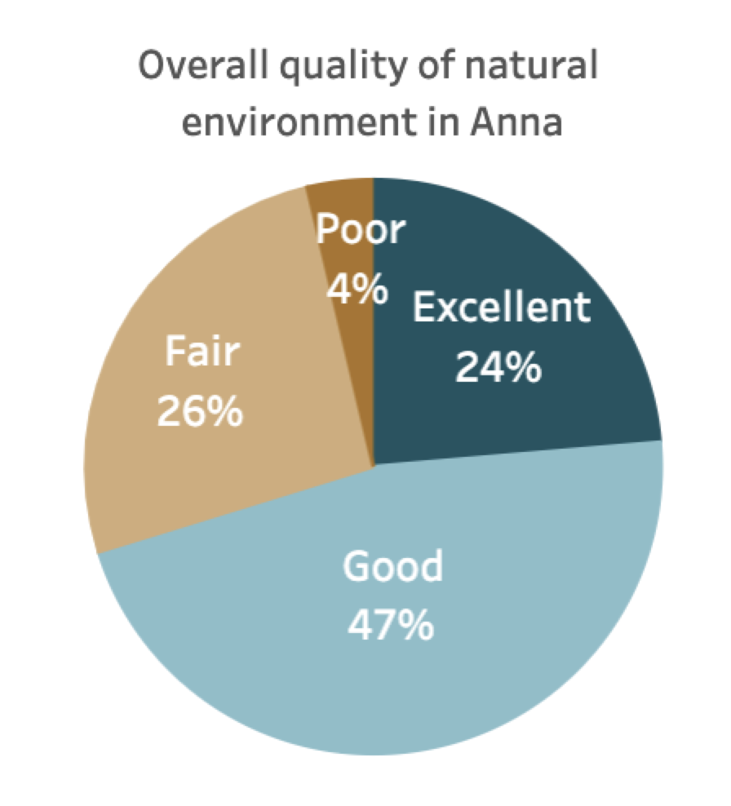
Natural Environment/Parks and Recreation in Anna
Recycling
Air quality
Cleanliness
Anna open space
Preservation of natural areas
Water Resources
Yard waste pick-up
76%
71%
70%
64%
55%
53%
23%
Notes:
Ratings for survey items related to the City's natural environment tended to be positive, with 70% of residents giving excellent or good reviews to the overall quality of natural environment in Anna. About 7 in 10 offered positive evaluations of the City's cleanliness, recycling services, and air quality, while at least half were pleased with Anna’s open space and preservation of natural areas. However, water resources were positively rated by only 24% of residents, scoring much lower than benchmark comparisons. Results

Slide 20
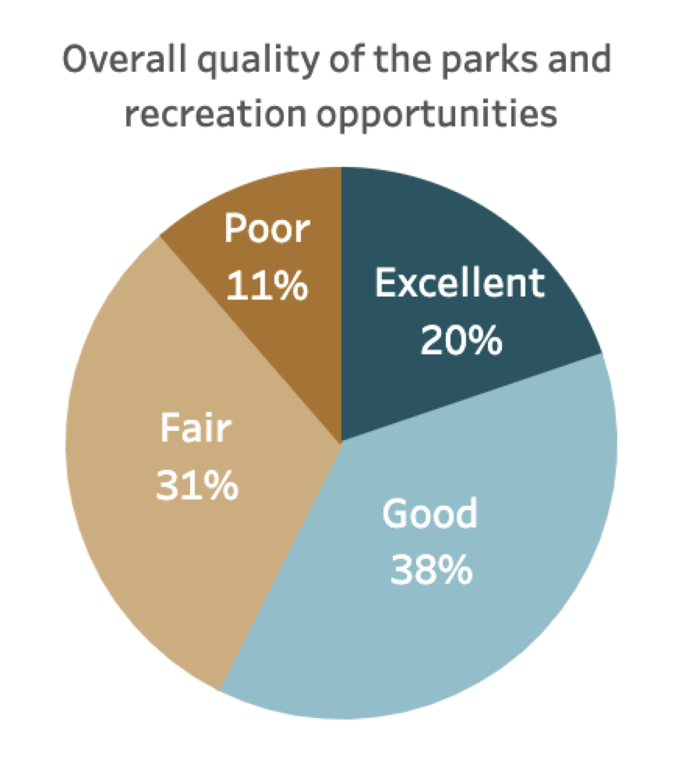
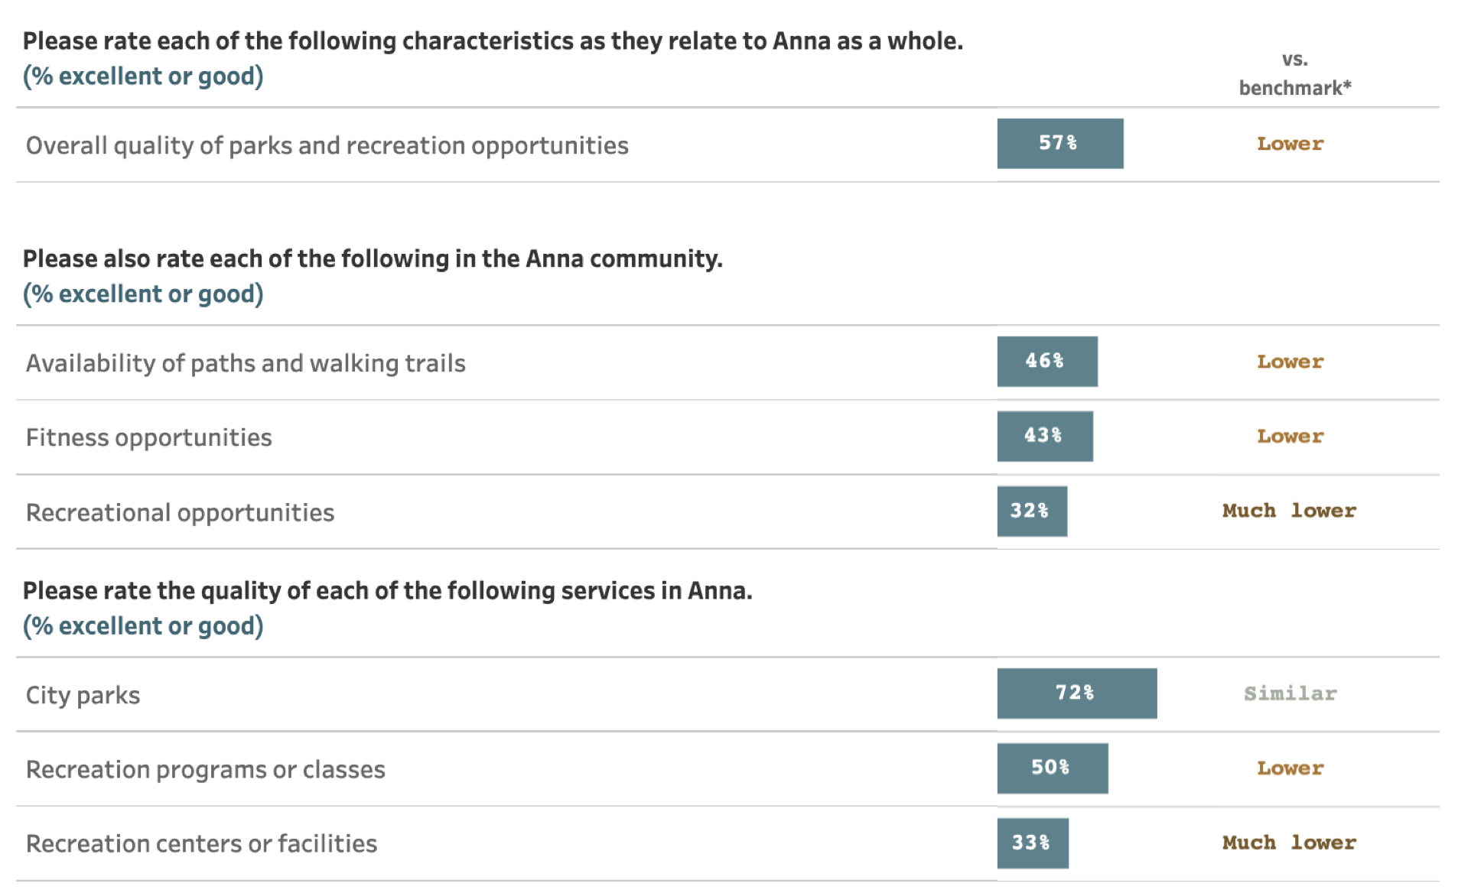
Natural Environment/Parks and Recreation in Anna
Notes:
Results related to parks and recreation also showed room for attention and growth, with most results being lower or much lower than national averages. About 7 in 10 residents were pleased with city parks, scoring similar to benchmark comparisons. Close to 6 in 10 residents positively rated the overall quality of parks and recreation opportunities, while 50% or less favorably rated recreation programs/classes, fitness opportunities, and the availability of walking paths or trails, all falling lower than the national average. About 3 in 10 residents were pleased with recreational opportunities and recreation centers or facilities, scoring much lower than benchmark comparisons.

Slide 21

Residents value the City’s infrastructure but have concerns about quality
Key Finding #4:

Slide 22
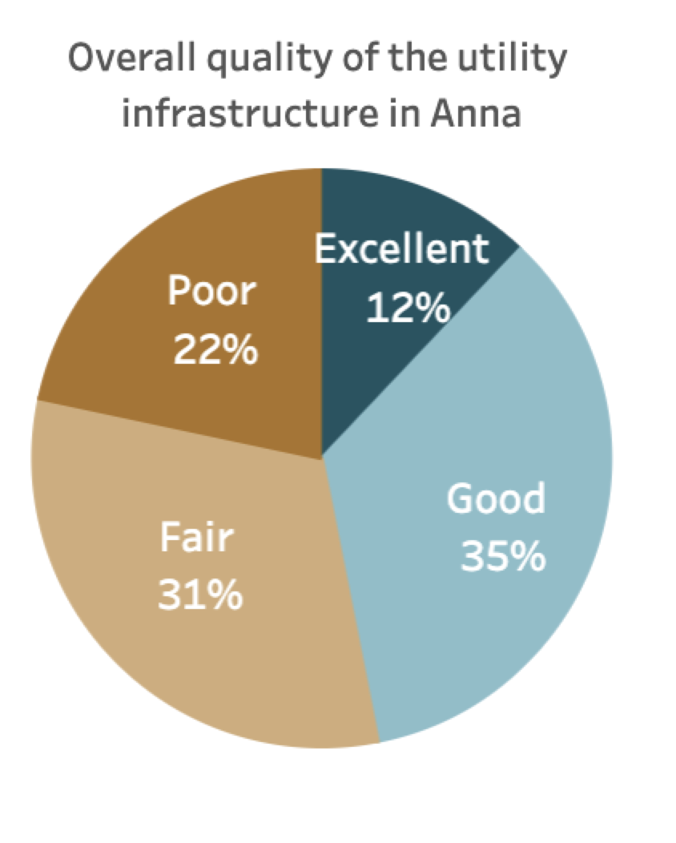
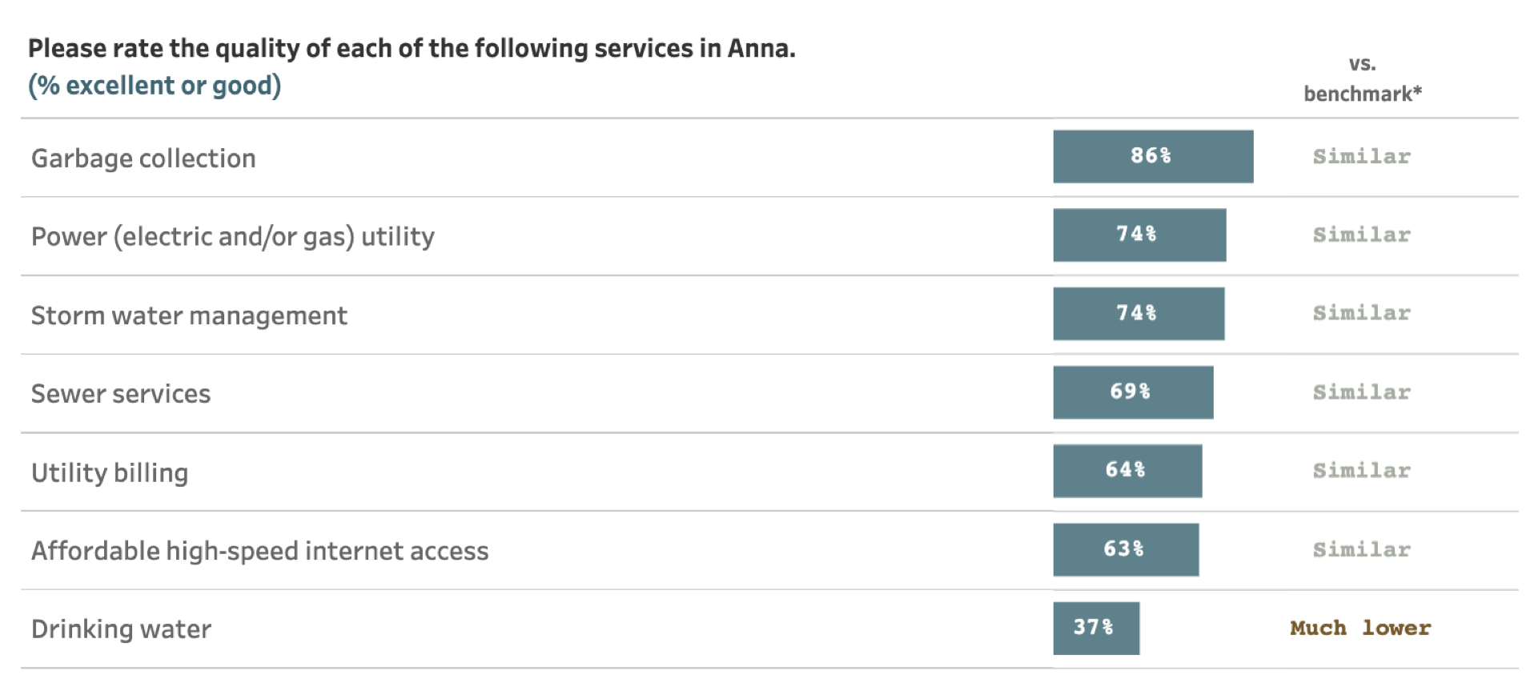
Utilities in Anna
Notes:
When asked which aspects of the community Anna should focus on in the next two years, 92% of residents identified the overall utility infrastructure as a priority. Less than half of participants (47%) gave high marks to the quality of the utility infrastructure in Anna, scoring below the national average. Garbage collection had positive reviews by 86% of residents. About 7 in 10 residents offered excellent or good reviews for power (electric and/or gas), storm water management, and sewer services. Only 37% of residents positively reviewed Anna’s drinking water, indicating that this could be an area of focus for the City.

Slide 23
Most residents feel a strong sense of safety in Anna.
Anna’s economic health is important to residents.
Residents feel Anna’s natural environment and recreational opportunities are important and have room for growth.
Residents value the City’s infrastructure but have concerns about quality.
Conclusions
Notes:
This has been a summary of the key findings highlighted in this presentation. I’ll reiterate that these are things we at Polco found interesting.
As you dig into the results, you may find other noteworthy results. It is my hope, and that of the organization I work for, NRC, that you and City staff will find this information useful. In the PDF and the online report, we provide a great deal of information including detailed responses for every survey question and breakdowns of results by respondent characteristics.

Slide 24

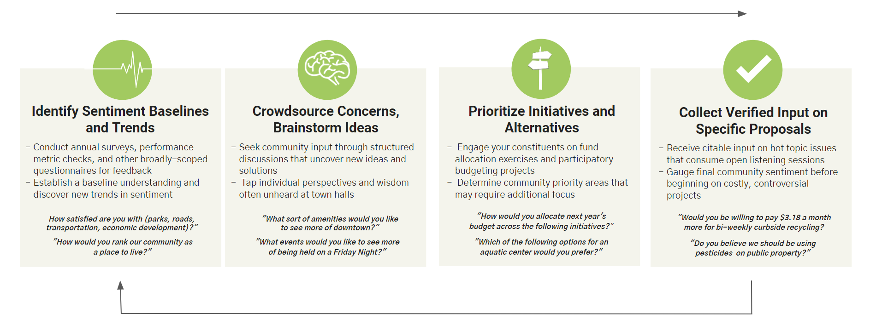
Continue Engagement Through The Policy Lifecycle
Don't let the community input and dialogue conclude with the survey.
Identify opportunities for improvement. Engage along the way to cultivate buy-in. Demonstrate progress. Repeat.
Notes:
I want to mention that the city’s existing subscription includes ongoing access to Polco’s online digital engagement platform. This is a great opportunity to post follow up questions on the platform to gather additional resident input on any topics you would like to dig deeper into.

Slide 25
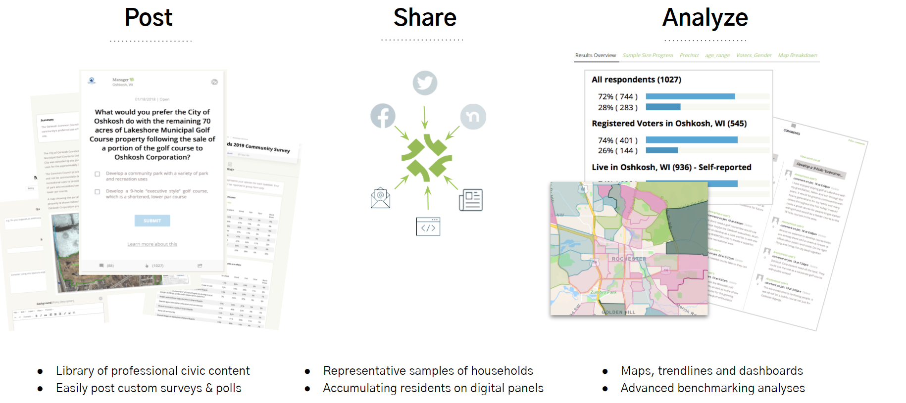
It’s Easy To Continue To Engage Your Panel
Notes:
If you wish to dig deeper to find out more about the opinions and perceptions of residents, you can continue to engage with your community on Polco.

Slide 26
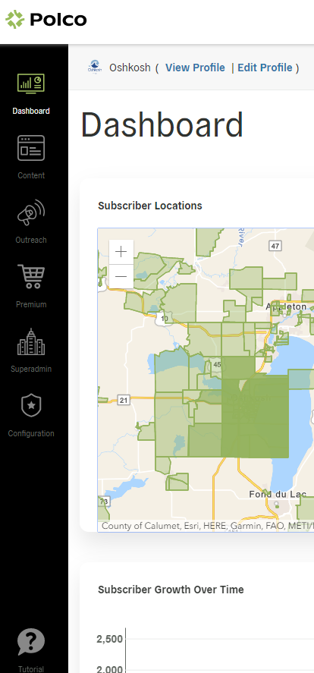
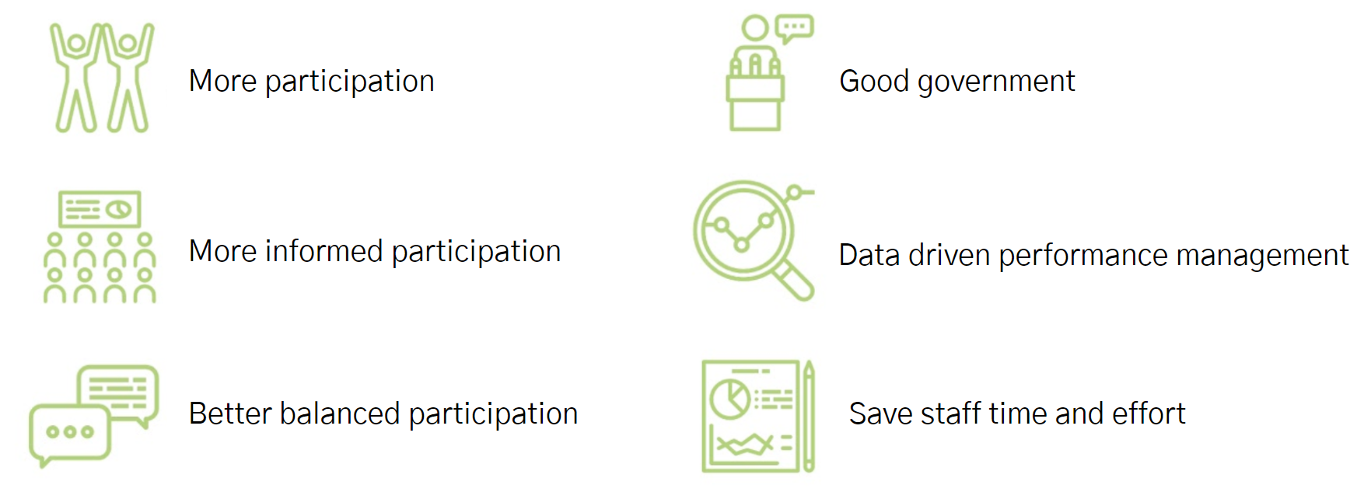
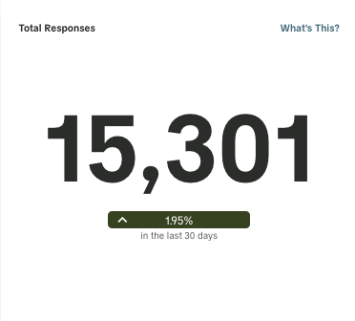
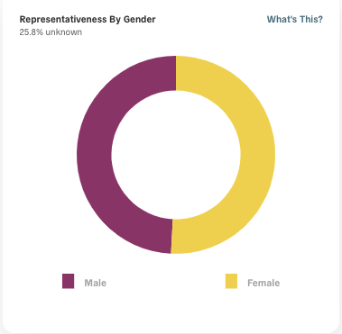
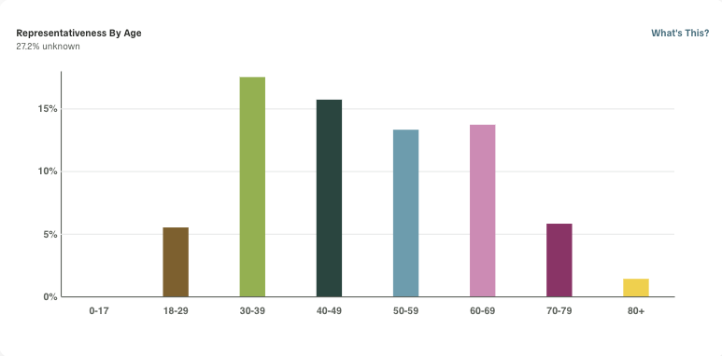
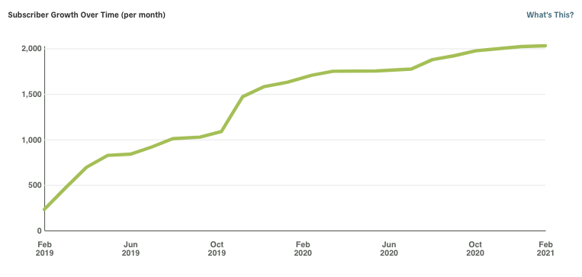
The Process To Deliver Great Outcomes
Notes:
Share new questions through social media, email, in-person events, local media, and other channels as appropriate. Engage with your online community panel to:
Ask follow-up questions to your community survey. Questions can include images (maps, pictures, and video) in addition to links to better inform respondents.
Ask about hot topics and new policy issues as they arise
The City of Anna currently has xx241 panel participants – you can continue to ask questions and dialogue with these community members!

Slide 27
Questions?

Slide 28
Thank you!
Kim Daane
Survey Research Associate
Polco/National Research Center
kim@polco.us

